Slide 1


Slide 2
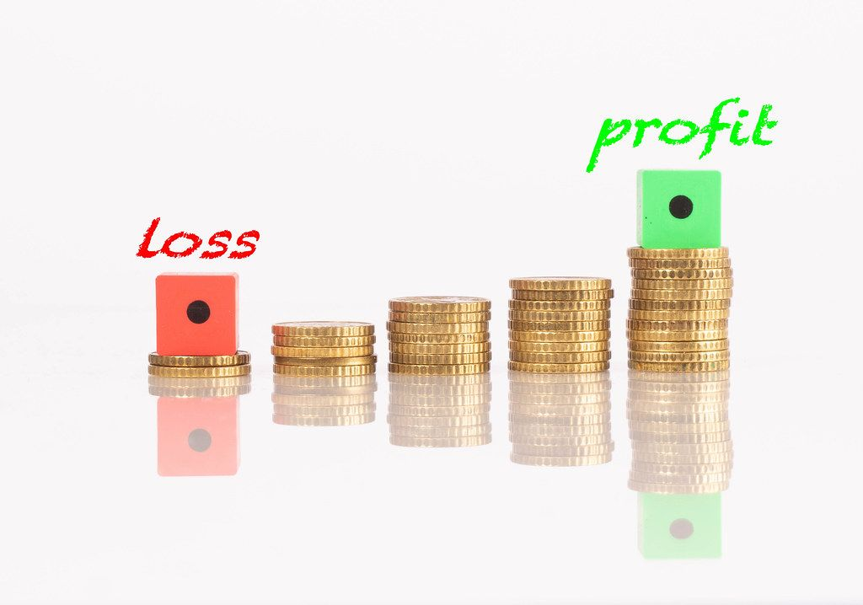
This Photo by Unknown Author is licensed under CC BY

Slide 3
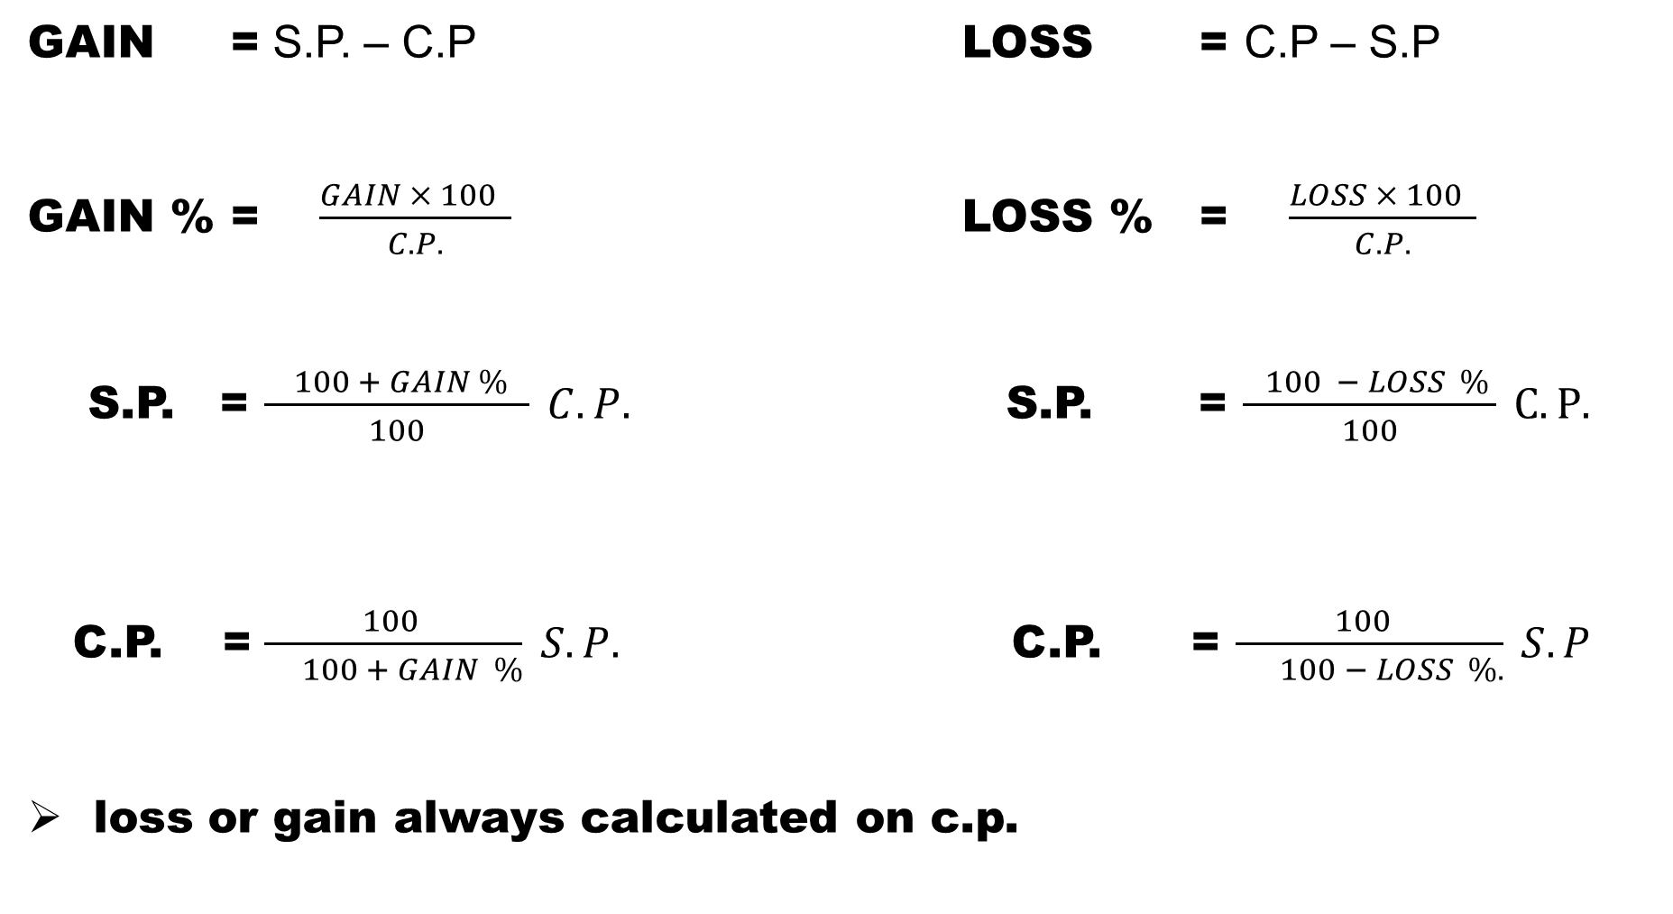
GAIN = S.P. – C.P LOSS = C.P – S.P
GAIN % =$\frac{GAIN × 100 }{C.P.}$ LOSS % = $\frac{LOSS × 100 }{C.P.}$
S.P. = $\frac{ 100 + GAIN \% }{100} C.P.$ S.P. = $\frac{ 100 − LOSS \% }{100} C.P.$
C.P. = $\frac{ 100 }{ 100 + GAIN \%} S.P.$ C.P. = $\frac{100 }{ 100 − LOSS \%.} S.P$
loss or gain always calculated on c.p.

Slide 4
(1) A shopkeeper sold an article for Rs. 2090.42. Approximately, what will be the percentage profit if he sold that article for Rs 2602.58 ?
(a) 15% (b) 20%
(c) 25% (d) 30%

Slide 5
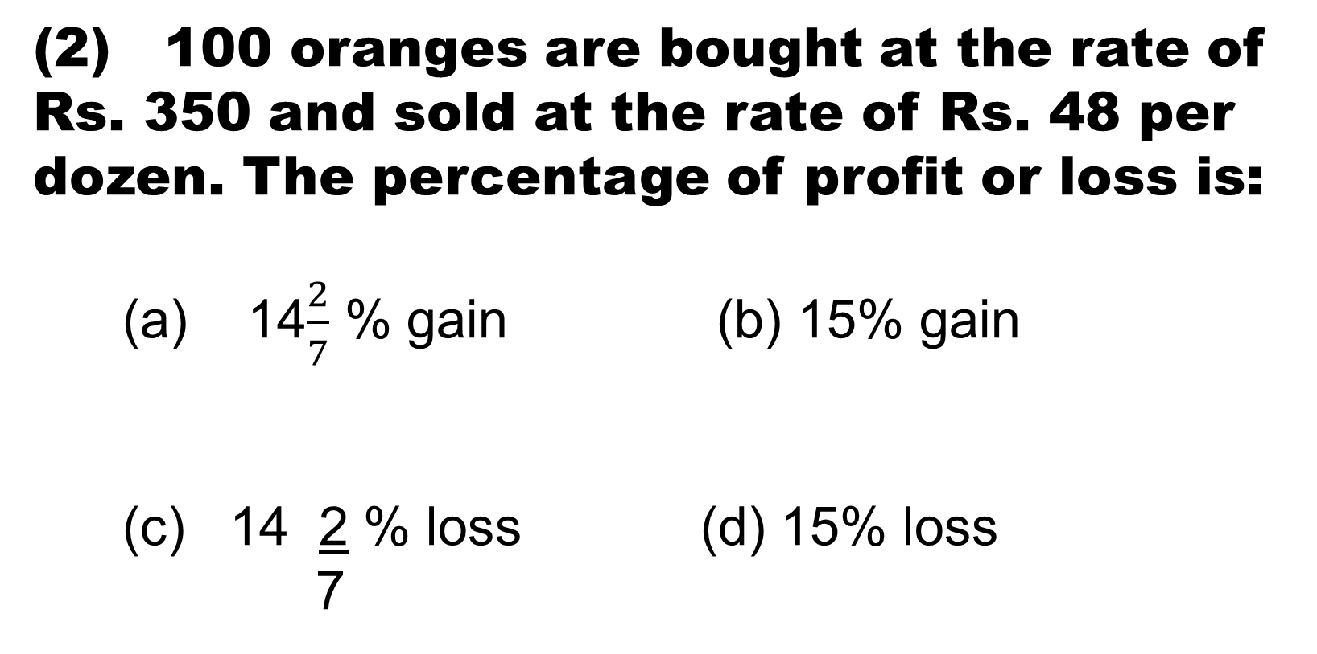
(2) 100 oranges are bought at the rate of Rs. 350 and sold at the rate of Rs. 48 per dozen. The percentage of profit or loss is:
(a) 14$\frac{2}{7}$ % gain (b) 15% gain
(c) 14 2 % loss (d) 15% loss
7

Slide 6
(3) A man buys a cycle for Rs. 1400 and sells it at a loss of 15%. What is the selling price of the cycle?
(a) Rs 1090 (b) Rs. 1160
(c) Rs 1190 (d) Rs 1202

Slide 7
(4) A sells an article which costs him Rs. 400 to B at a profit of 20%. B then sells it to C, making a profit of 10% on the price he paid to A. How much does C pay B ?
(a) Rs. 472 (b) Rs. 476
(c) Rs. 528 (d) Rs. 532

Slide 8
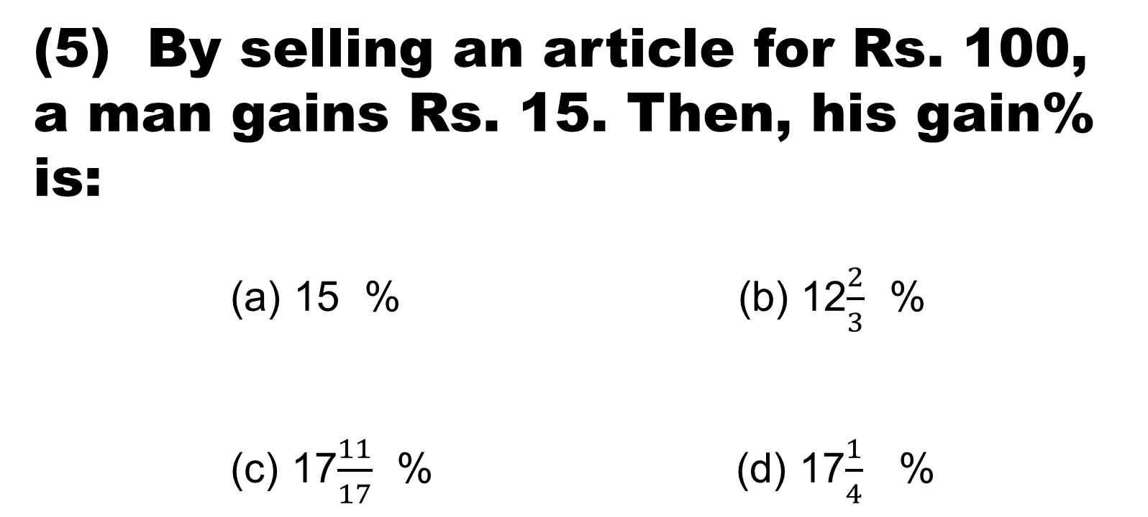
(5) By selling an article for Rs. 100, a man gains Rs. 15. Then, his gain% is:
(a) 15 % (b) 12$\frac{2}{3}$ %
(c) 17$\frac{11}{17}$ % (d) 17$\frac{1}{4}$ %

Slide 9
(6) Akshay Bought a scooter for a certain sum of money. He spent 10% of the cost on repairs and sold the scooter for a profit of Rs. 1100, How much did he spend on repairs if he made profit of 20% ?
(a) Rs 400 (b) Rs. 440
(c) Rs. 500 (d) Rs. 550

Slide 10
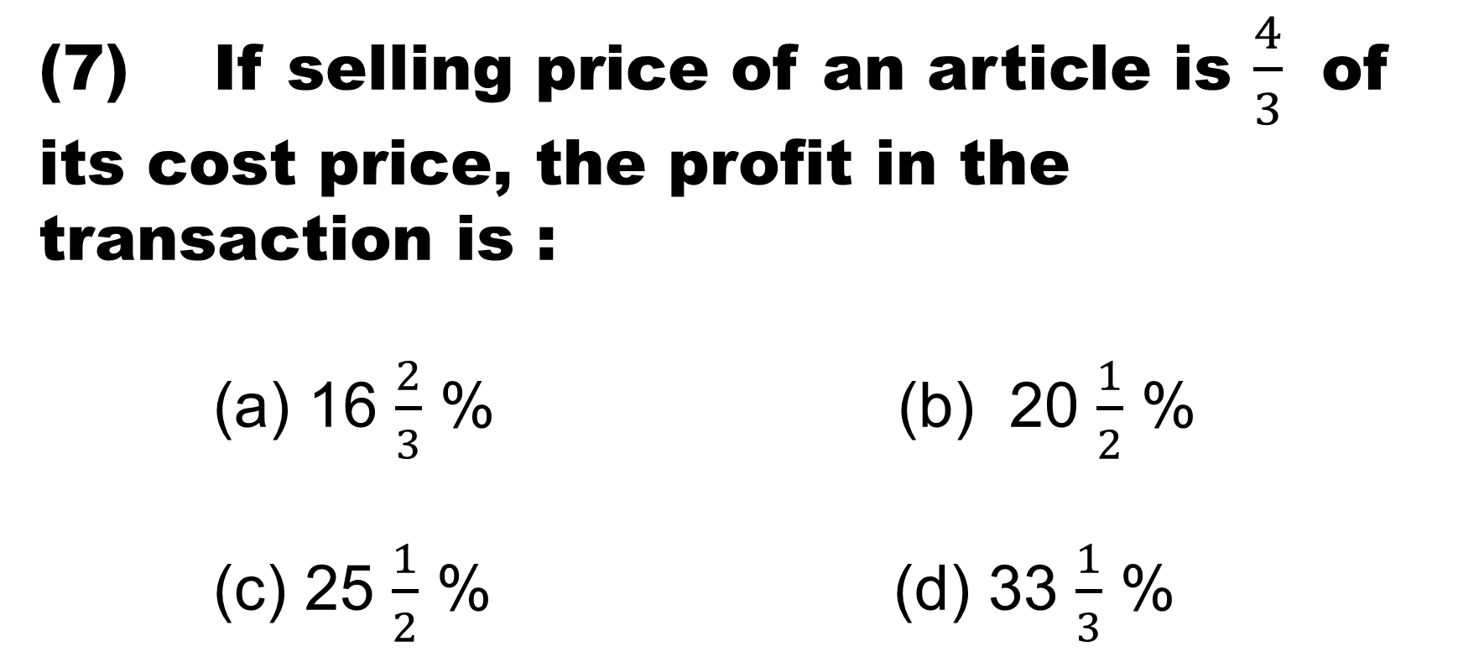
(7) If selling price of an article is $\frac{4}{3}$ of its cost price, the profit in the transaction is :
(a) 16 $\frac{2}{3}$ % (b) 20 $\frac{1}{2}$ %
(c) 25 $\frac{1}{2}$ % (d) 33 $\frac{1}{3}$ %

Slide 11
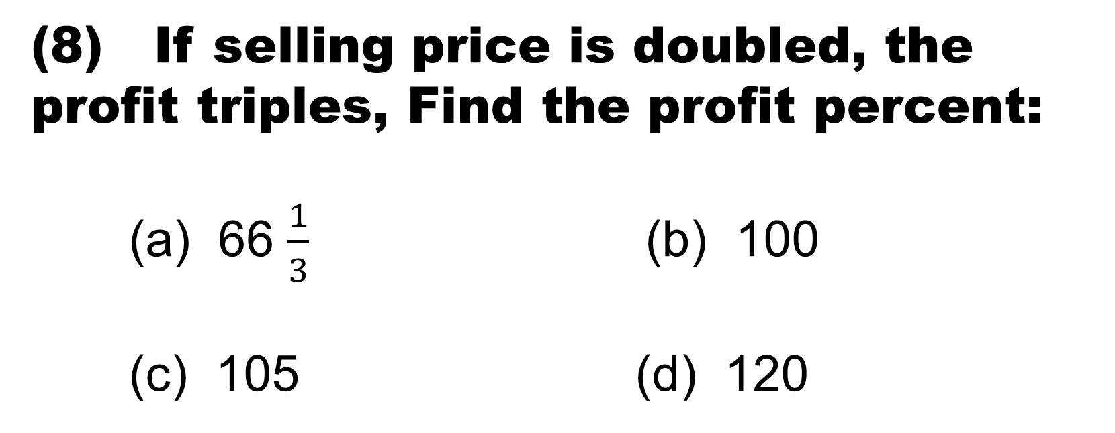
(8) If selling price is doubled, the profit triples, Find the profit percent:
(a) 66 $\frac{1}{3}$ (b) 100
(c) 105 (d) 120

Slide 12
At what profit percent , must an article be sold so that by selling at half that price there may be a loss of 30% ?
(a) 25% (b) 36%
(c) 40% (d) 42%

Slide 13
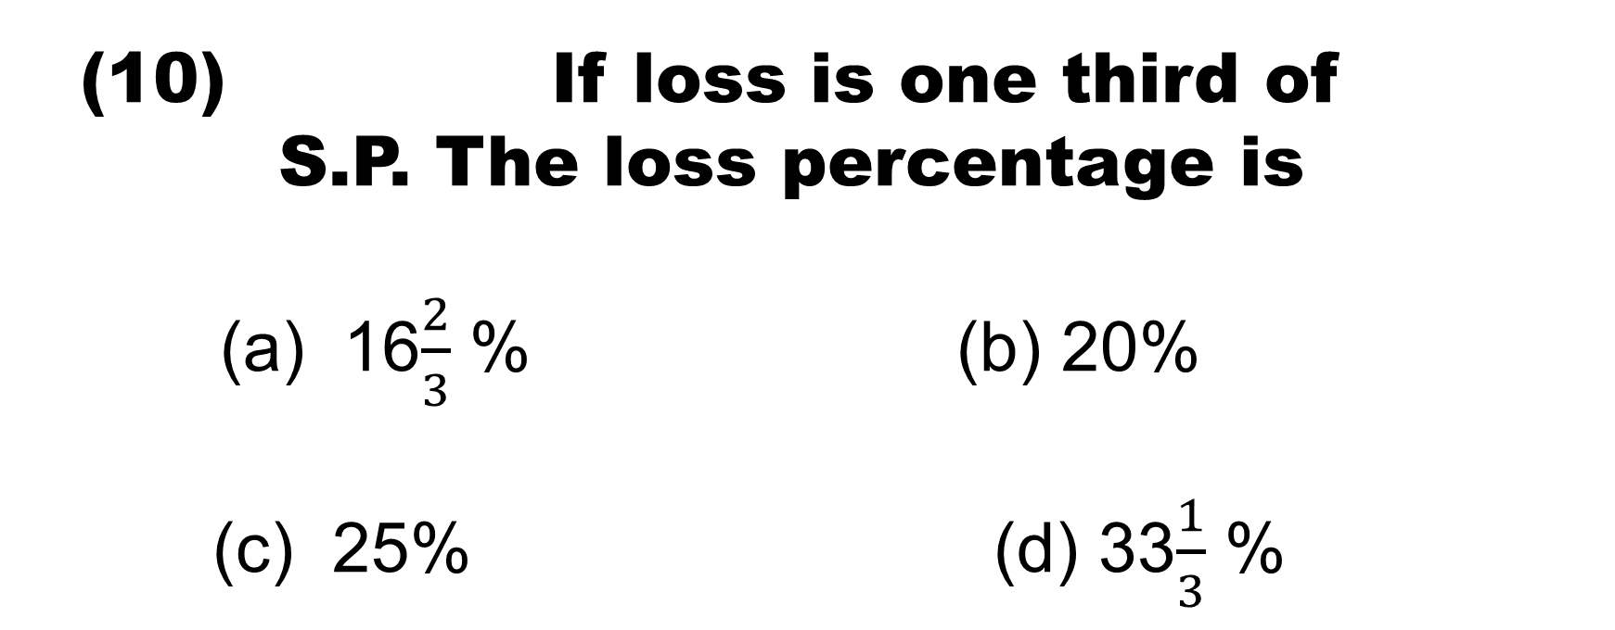
If loss is one third of
S.P. The loss percentage is
(a) 16$\frac{2}{3}$ % (b) 20%
(c) 25% (d) 33$\frac{1}{3}$ %

Slide 14
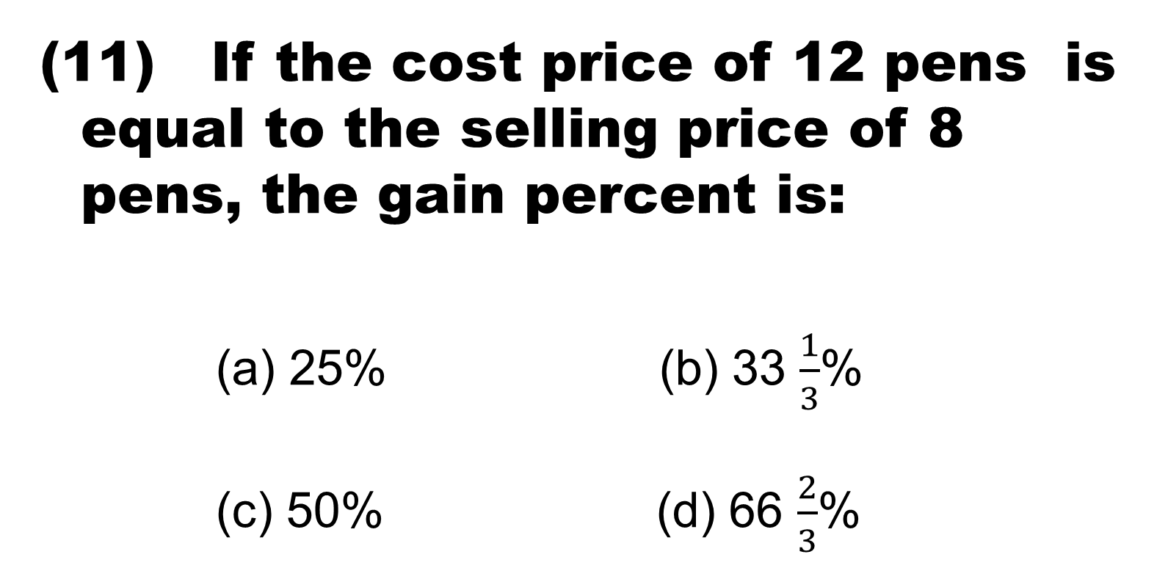
If the cost price of 12 pens is equal to the selling price of 8 pens, the gain percent is:
(a) 25% (b) 33 $\frac{1}{3}$%
(c) 50% (d) 66 $\frac{2}{3}$%

Slide 15
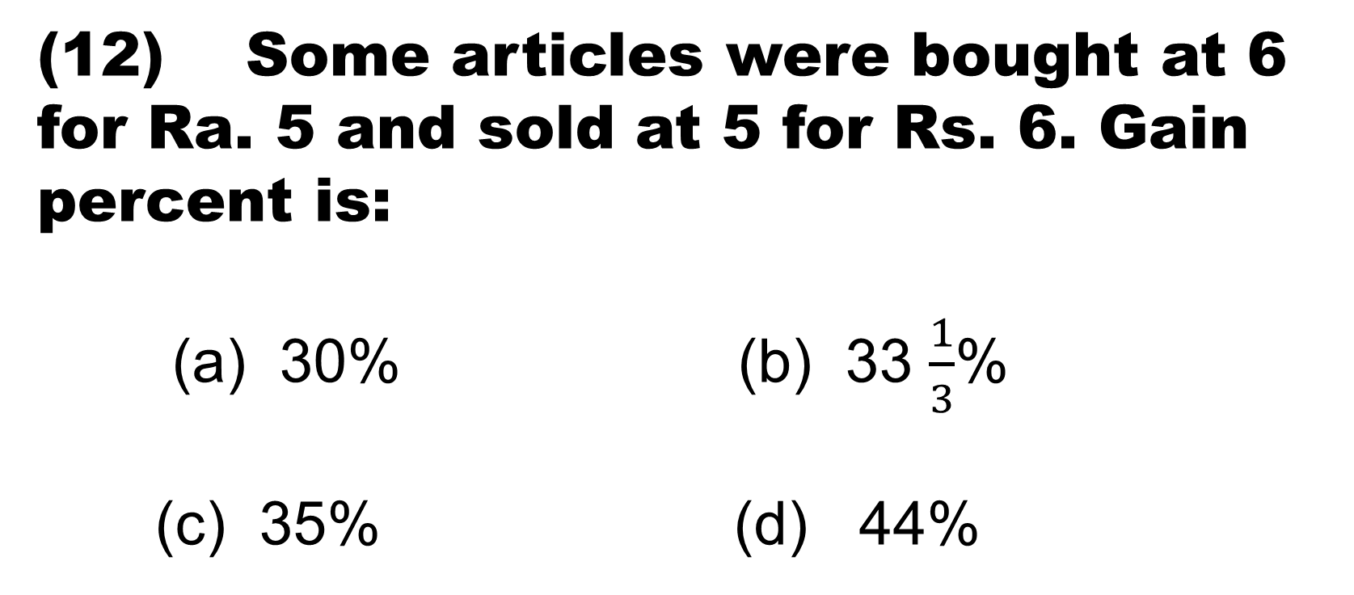
(12) Some articles were bought at 6 for Ra. 5 and sold at 5 for Rs. 6. Gain percent is:
(a) 30% (b) 33 $\frac{1}{3}$%
(c) 35% (d) 44%

Slide 16
(13) A vender bought toffees at 6 for a rupee. How many for a rupee must he sell to gain 20% ?
(a) 3 (b) 4
(c) 5 (d) 6

Slide 17
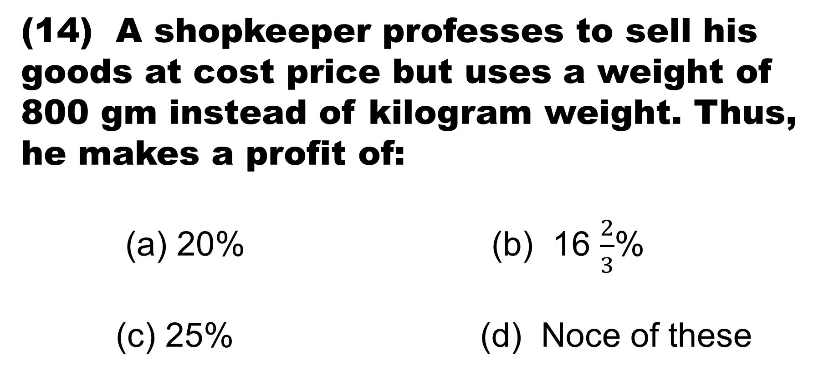
(14) A shopkeeper professes to sell his goods at cost price but uses a weight of 800 gm instead of kilogram weight. Thus, he makes a profit of:
(a) 20% (b) 16 $\frac{2}{3}$%
(c) 25% (d) Noce of these

Slide 18
A sells a bicycle to B at a profit of 20% B sells it to C at a profit of 25%. If C pays Rs. 225 for it, the cost price of the bicycle for A is:
(a) Rs. 110 (b) Rs. 120
(c) R. 125 (d) Rs. 150

Slide 19
Samant bought a microwave oven and paid 10% less than the original price. He sold it with 30% profit on the price he had paid. What percentage of profit did Samant earn on the original price?
(a) 17% (b) 20%
(c) 27% (d) 32%

Slide 20
(17) The difference between the cost price and sale price of an article is Rs. 240. If the profit is 20%, the selling price is:
(a) Rs. 1240 (b) Rs. 1400
(c) Rs. 1600 (d) None of these

Slide 21
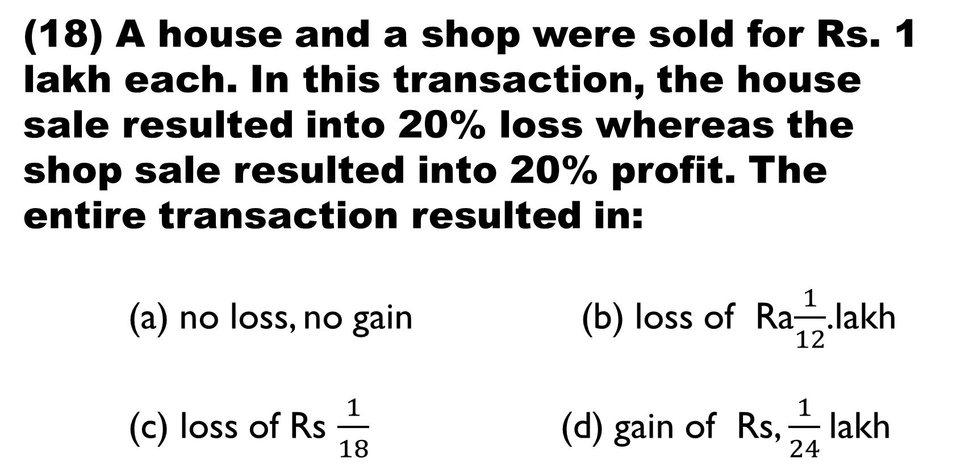
(18) A house and a shop were sold for Rs. 1 lakh each. In this transaction, the house sale resulted into 20% loss whereas the shop sale resulted into 20% profit. The entire transaction resulted in:
(a) no loss, no gain (b) loss of Ra$\frac{1}{12}$.lakh
(c) loss of Rs $\frac{1}{18}$(d) gain of Rs, $\frac{1}{24}$lakh

Slide 22
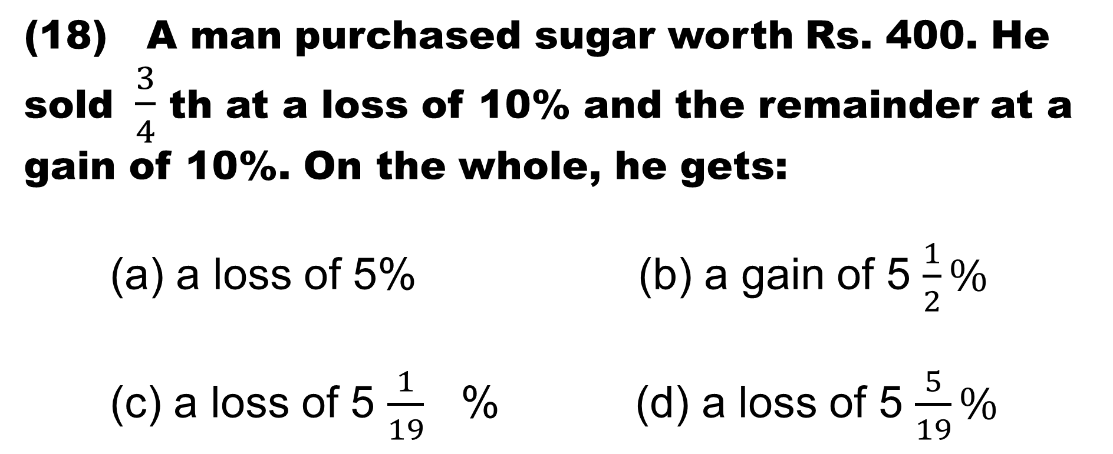
(18) A man purchased sugar worth Rs. 400. He sold $\frac{3}{4}$ th at a loss of 10% and the remainder at a gain of 10%. On the whole, he gets:
(a) a loss of 5% (b) a gain of 5 $\frac{1}{2}\%$
(c) a loss of 5 $\frac{1}{19}$ % (d) a loss of 5 $\frac{5}{19}\%$

Slide 23
(20) A bag marked at Rs. 80 is sold for Rs. 68. The rate of discount is:
(a) 12% (b) 15%
(c) 17% (d) 20%

Slide 24
(21) A shopkeeper gives 12% additional discount on the discounted price, after giving an initial discount of 20% on the labelled price of a radio. If the final sale price of the radio is Rs. 704, then what is its labelled price?
(a) Rs. 844.80 (b) Rs. 929.28
(c) Rs. 1000 (d) Rs. 1044.80

Slide 25
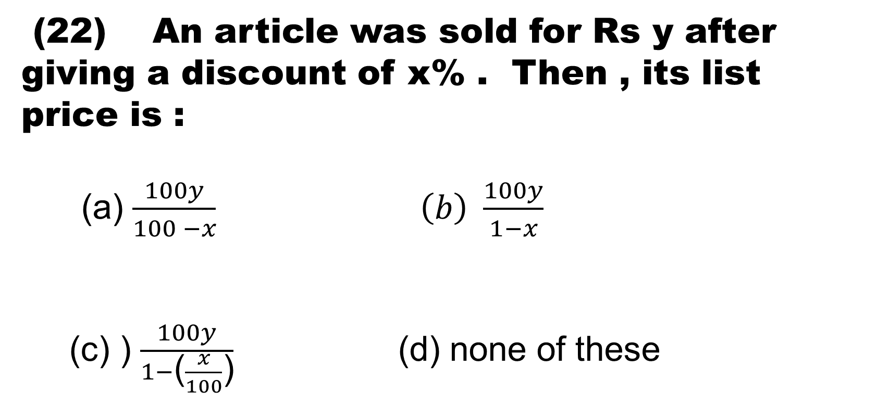
(22) An article was sold for Rs y after giving a discount of x% . Then , its list price is :
(a) $\frac{100y}{100 −x} \left(b\right) \frac{100y}{1−x}$
(c) ) $\frac{100y}{1−\text{(}\frac{x}{100}\text{)}}$ (d) none of these

Slide 26
(23) The price of a VCR is marked at Rs. 12,000. If successive discounts of 15%, 10% & 5% be allowed, then at what price does a customer buy it?
(a) Rs. 8400 (b) Rs. 8721
(c) Rs. 8856 (d) None of these

Slide 27
Two shopkeepers announce the same price of Rs. 700 for a sewing machine. The first offers successive discounts of 30% and 6% while the second offers successive discounts of 20% and 16%. The shopkeeper that offers better discount, charges...... less that the other shopkeeper.
(a) Ra. 9.80 (b) Rs. 16.80
(c) Rs. 22.40 (d) Rs. 36.40

Slide 28
(25) A trader marked the price of his commodity so as to include a profit discount of 25%. He allowed discount of 16% on the marked price. His actual profit was:
(a) 5% (b) 9%
(c) 16% (d) 25%

Slide 29
(26) The cost price of an article is 64% of the marked price. Calculate the gain percent after allowing a discount of 12%
(a) 37.5% (b) 48%
(c) 50.5% (d) 52%

Slide 30
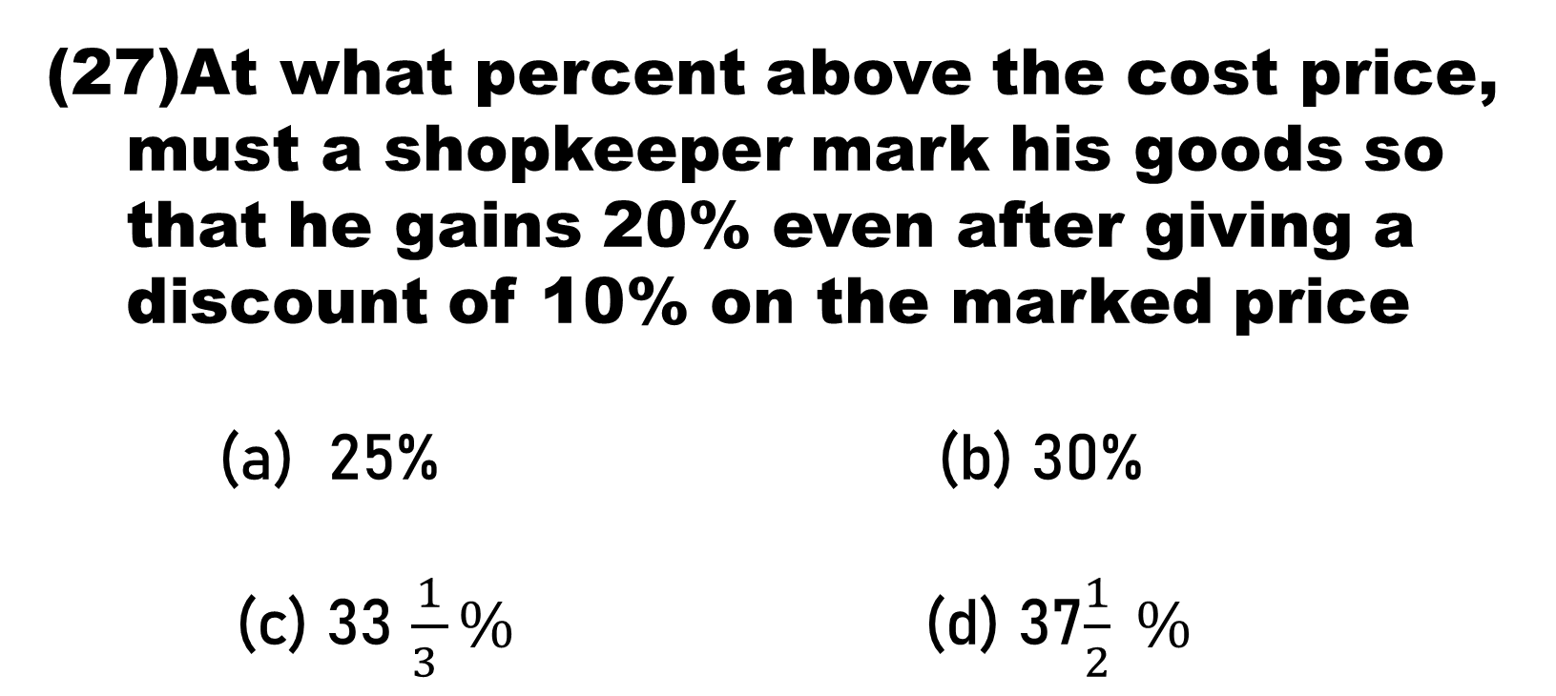
At what percent above the cost price, must a shopkeeper mark his goods so that he gains 20% even after giving a discount of 10% on the marked price
(a) 25% (b) 30%
(c) 33 $\frac{1}{3 }\%$ (d) 37$\frac{1}{2} \%$

Slide 31
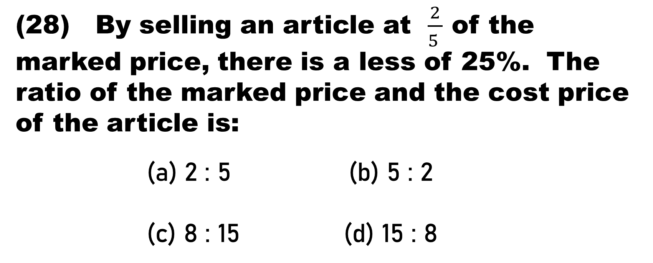
(28) By selling an article at $\frac{2}{5 }$ of the marked price, there is a less of 25%. The ratio of the marked price and the cost price of the article is:
(a) 2 : 5 (b) 5 : 2
(c) 8 : 15 (d) 15 : 8

Slide 32
(29) A trader marked the selling price of an article at 10% above the cost price. At the time of selling, he allows certain discount and suffers a loss of 1%. He allowed a discount of:
(a) 9% (b) 10%
(C) 10.5% (d) 11%

Slide 33
(30) Komal buys an article at a discount of 25%. At what percentage above the cost price should he sell it to make a profit of 25% over the original list price?
(a) 25 (b) 30
(C) 40 (d ) 66.67

Slide 34


